Slide 1



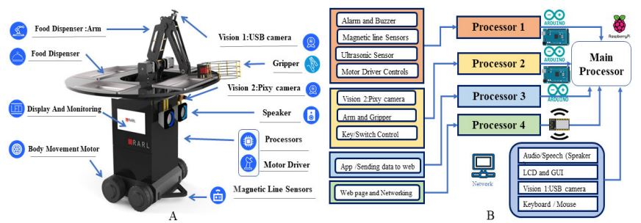
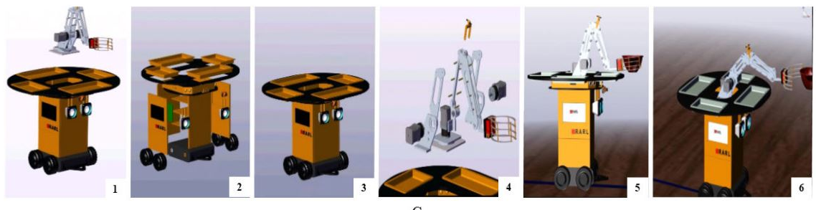
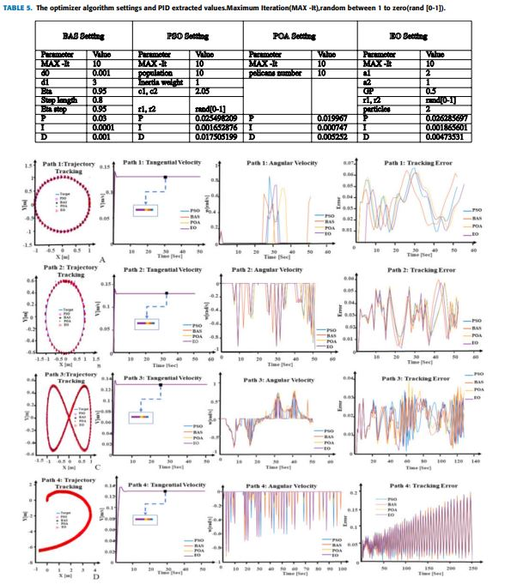
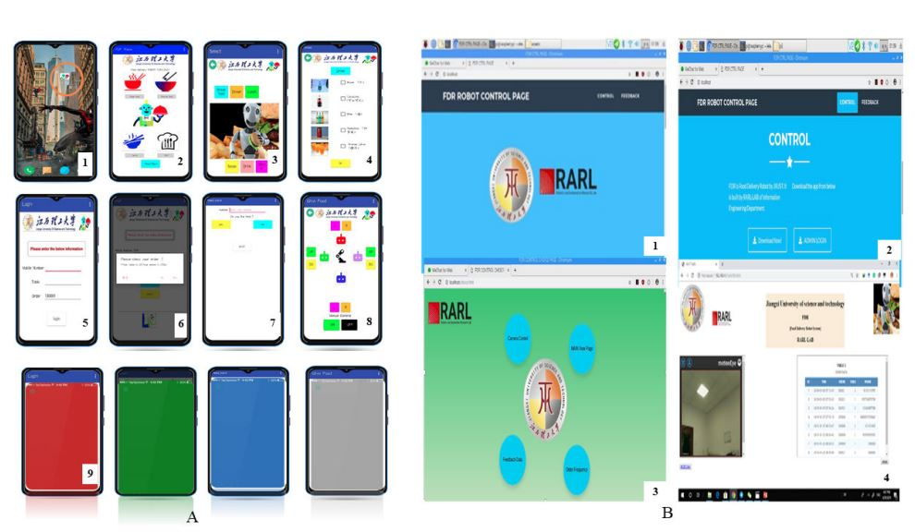


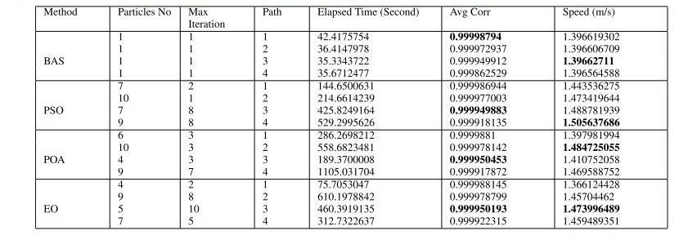
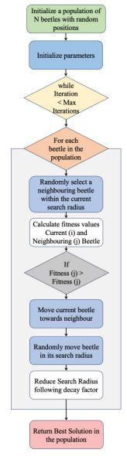
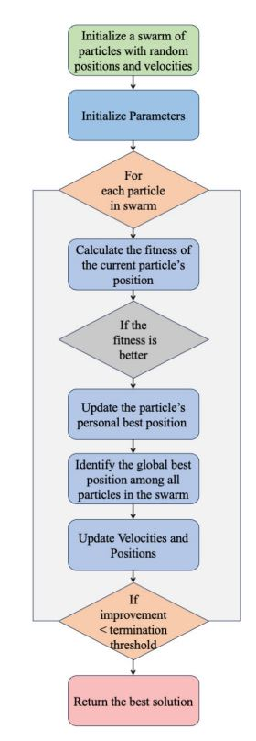
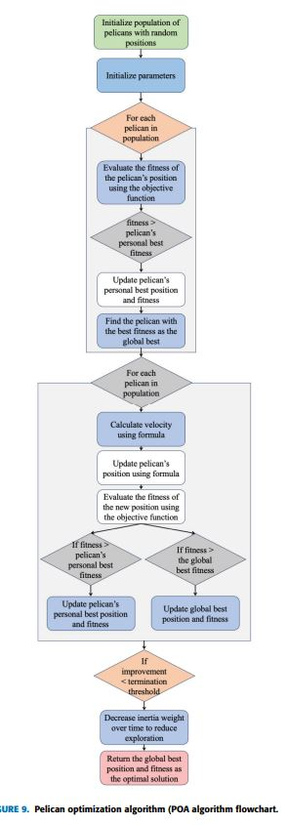
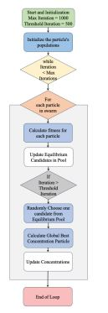
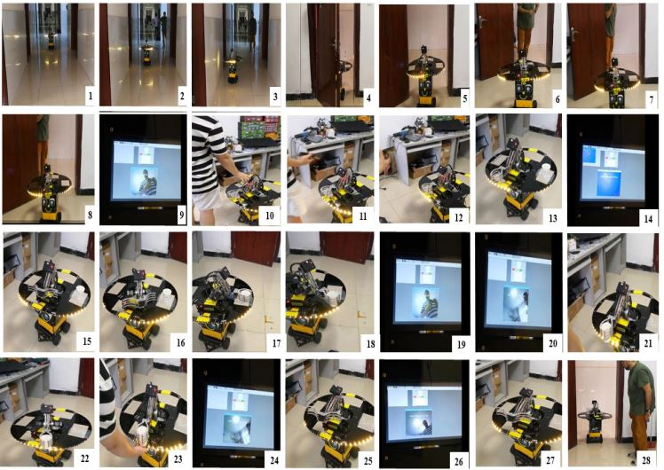


Design and Development of FOODIEBOT
Robot: From Simulation to Design
Abstract
INTRODUCTION
FOODIEBOT(shortened name for food delivery robot) an adaptive service automaton with a wide range of functionalities. The model underwent meticulous scrutiny through detailed simulations using MATLAB software. its operational efficiency navigating through circular, elliptical, spiral, and octagonal trajectories underwent rigorous examination, utilizing optimization methodologies like Beetle Antennae Search (BAS) Algorithm, Particle Swarm Optimization (PSO), Pelican Optimization Algorithm (POA), and Equilibrium Optimizer (EO). Robot benchmarks, validation of simulation accuracy and reliability in extracting PID controller values. In the comprehensive evaluation of the methods and effectiveness of the robotic system, the BAS technique Superior in operational efficiency. This method consistently outperforms its counterparts in runtime. It is primarily due to the precise optimization of the number of particles. Comparative analysis among different types
The tracks show some interesting insights
Service robots are being increasingly deployed to perform useful tasks in various settings, from healthcare to logistics. They can improve efficiency and convenience by alleviating human workloads, especially in challenging industries. The adoption of service robots has increased by 9.1% since 2022, with high acceptance levels. Service robots are being used for a wide range of tasks in hospitals, from basic cleaning to advanced surgical systems. The COVID-19 pandemic has also created new opportunities for service robots to minimize virus transmission by taking on tasks that require direct human contact. Research is ongoing to improve service robots' capabilities in daily home tasks, such as organizing groceries and rearranging household items, with a focus on enhancing manipulation and adaptability.
DISCUSSION
RESULTS
- The BAS technique consistently outperformed the other optimization methods in terms of execution time, primarily due to its efficient optimization of particle count.
- The EO approach showed outstanding accuracy in Path 1, while the POA method achieved optimal precision in Path 3.
The BAS technique demonstrated unparalleled accuracy in
Path 4.
- In terms of maximum velocity, the PSO method excelled in Paths 1, 3, and 4, achieving the highest speeds, while Path 2 saw the peak velocity with the POA method.
FOODIEBOT robot is a comprehensive system comprising both hardware (combination of various sensors) and software (Mobile APP, and the Web Application) components working in harmony to execute a diverse range of tasks. Among these tasks, a pivotal one involves navigating and following predefined paths, placing food orders, identifying individuals at the ordering counter, delivering food or packages to recognized recipients, etc.
THE MOBILE APPLICATION The ‘FOODIEBOT Robot’ is a mobile application designed for ordering foods and controlling a robot arm in a manual setting. The app par Developed using MIT app-inventor
CONCLUSIONS
The final demonstration test successfully implemented the acquired PID values within the robot's logic, enabling it to adeptly track the predefined path for its delivery mission. The controlled testbed scenario provided a systematic and replicable environment for observations and assessments. The robot's operations involved following a predefined path using magnetic strips, detecting obstacles, and identifying the user through a color code and face recognition. The integration of various sensors and systems, such as the Pixy camera, ultrasonic sensors, and voice performance, enhanced the robot's capabilities and safety features. The designed FOODIT robot model offers distinctive features, including economical pricing, the ability to transport four dishes, and seamless integration with multiple platforms. The simulation results demonstrated that the choice of optimization method significantly impacted the accuracy and speed of the robot's performance across different paths. Among the optimization methods, the highest accuracy with an R-value of 0.99995 was achieved for the third path using the POA method, while the BAS method recorded the highest accuracy of R = 0.999988 for the first path. The BAS method generally exhibited the shortest execution time, while the maximum speed varied among the optimization techniques depending on the specific path.
METHODS AND MATERIALS
- The researchers used various optimization algorithms such as Beetle Antennae Search (BAS), Particle Swarm Optimization (PSO), Pelican Optimization Algorithm (POA), and Equilibrium Optimizer (EO) to optimize the PID controller coefficients for the FOODIEBOT robot.
- They conducted detailed simulations in MATLAB to study the performance of the robot in navigating through different trajectories (circular, elliptical, spiral, and octagonal).
- The operational efficiency of the robot was examined under these optimization techniques.
Published result
QR
QR

Slide 2
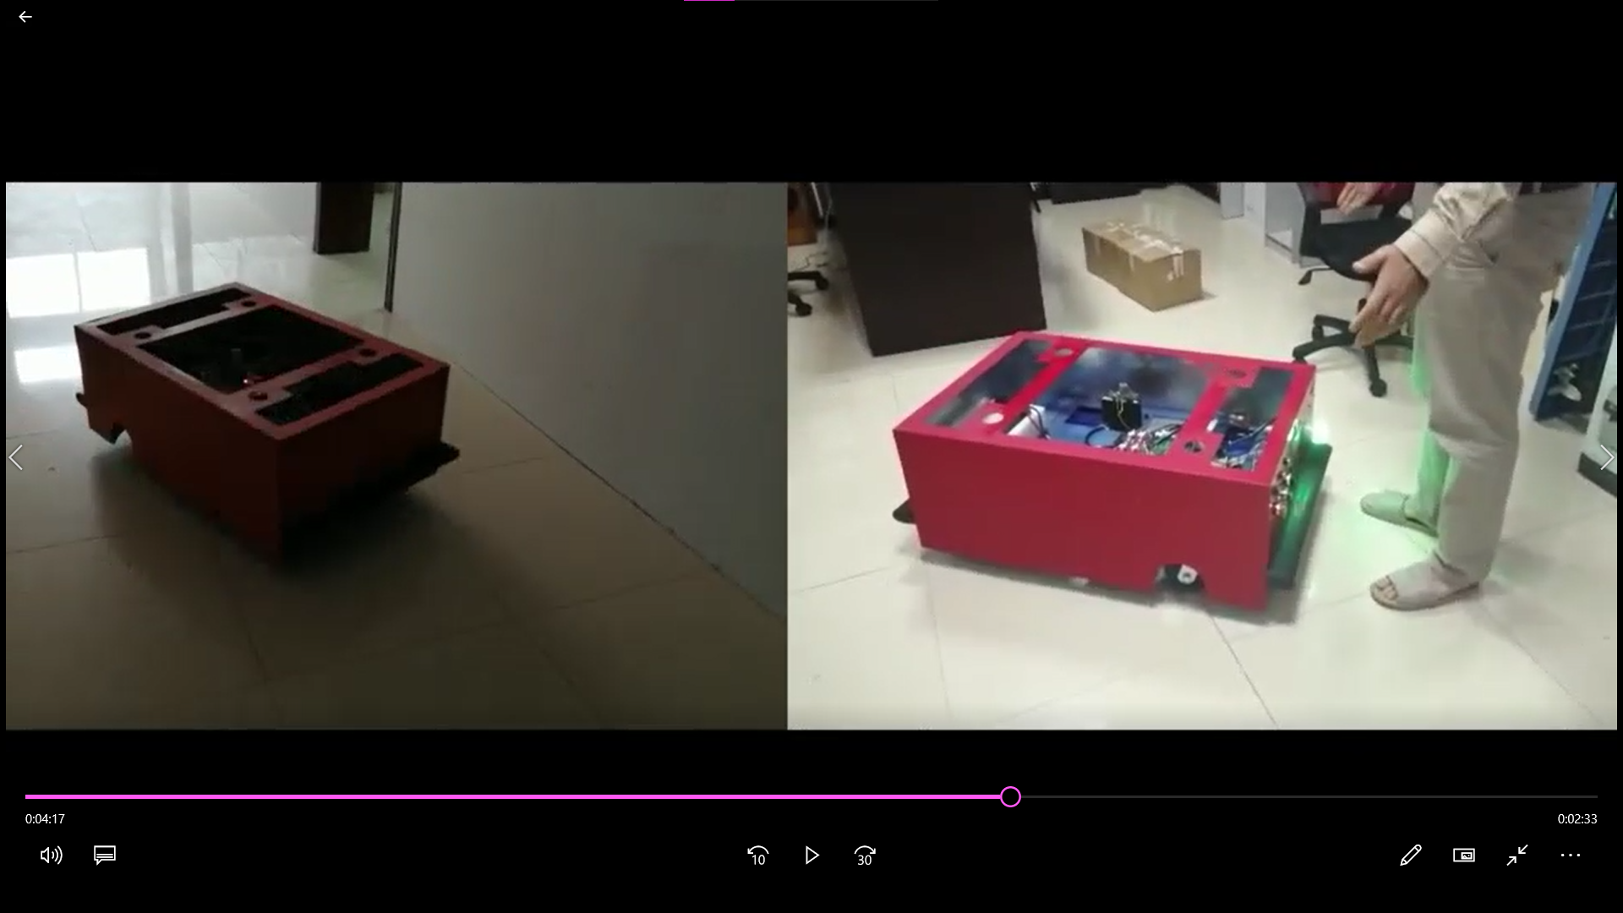
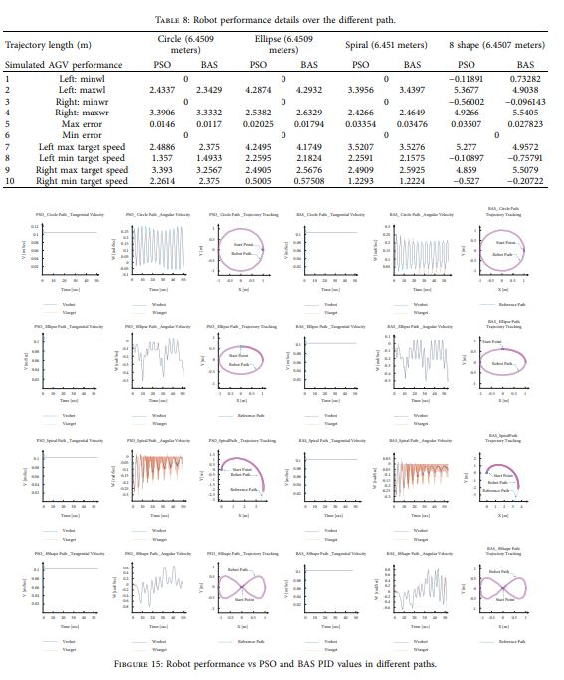
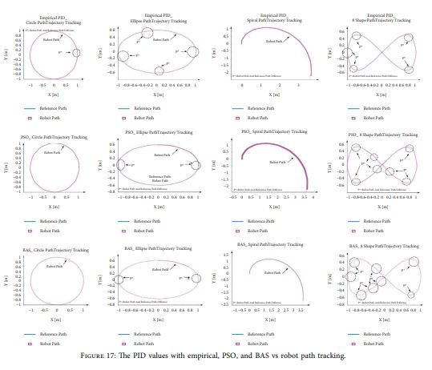
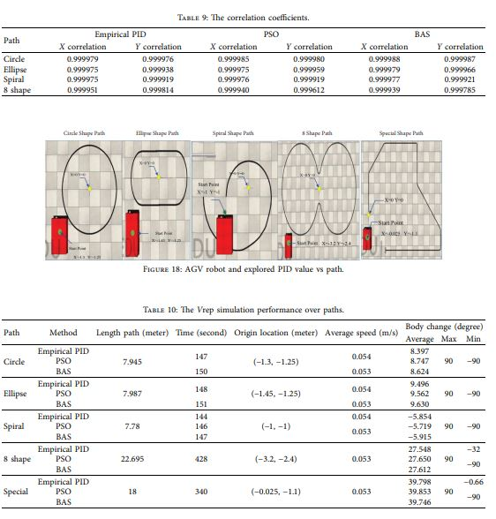
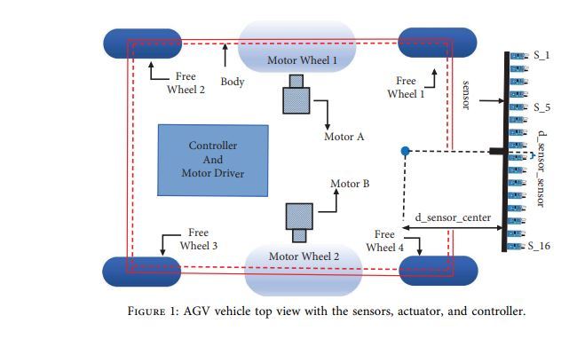
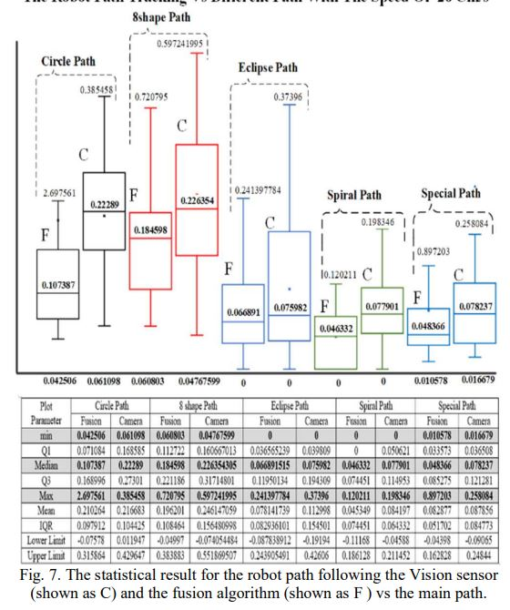
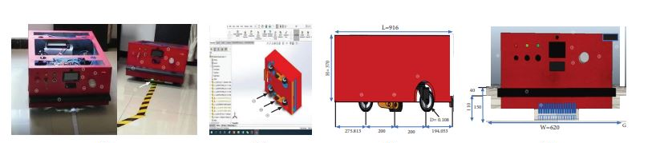
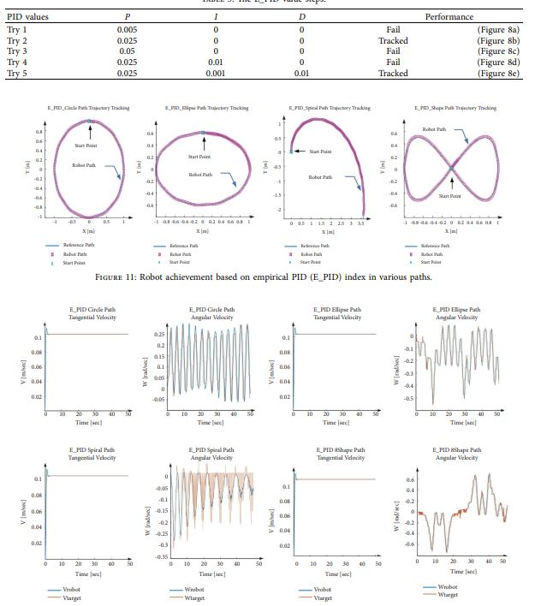
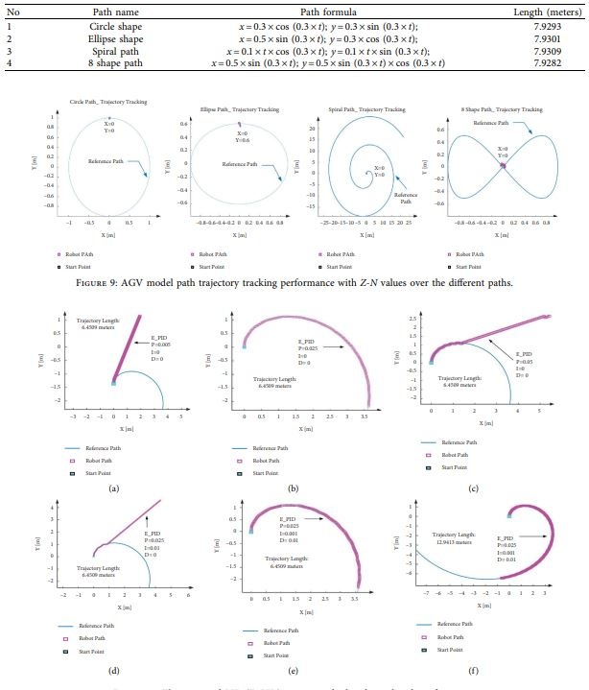
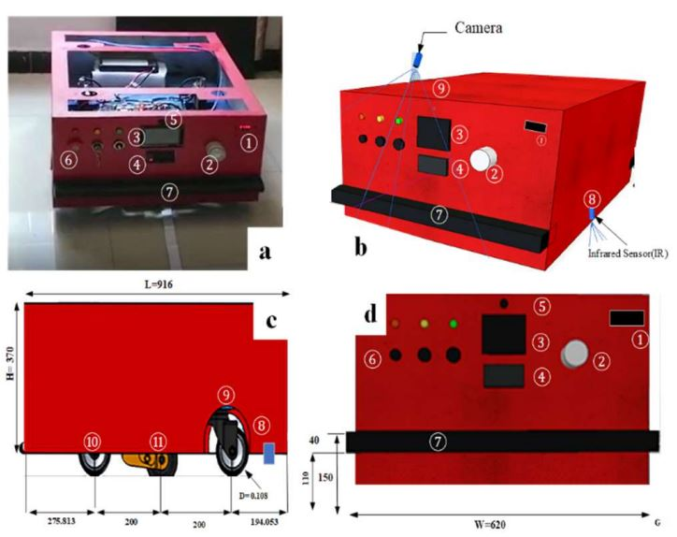
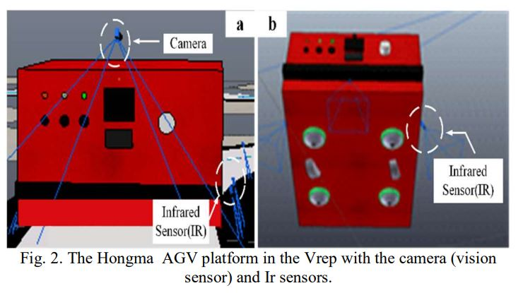
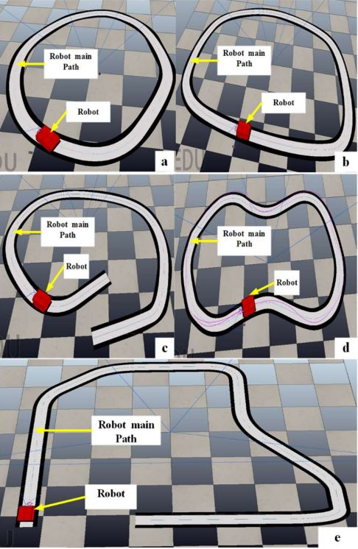
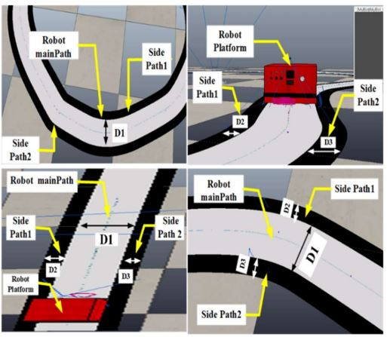
Simulation and Validation of Optimized PID Controller in AGV(Automated Guided Vehicles) Model Using PSO and BAS Algorithms
Fusion BASED AGV Robot Navigation Solution Comparative Analysis and Vrep Simulation
Abstract
INTRODUCTION
The paper evaluates different PID control tuning methods for automated guided vehicles (AGVs) using MATLAB simulation. The methods compared are Ziegler-Nichols, empirical, PSO, and BAS. Performance is tested on circle, ellipse, spiral, and 8-shaped paths. The results show the empirical, PSO, and BAS methods perform similarly well, with BAS being the fastest and PSO having the best overall performance. Simulation results were validated in CoppeliaSim.
Automated Guided Vehicles (AGVs), introduced in 1953, are essential in robotics and increasingly utilized across various industries, especially during COVID-19 for services in hotels, hospitals, and restaurants. AGVs consist of a frame, navigation systems, and various designs. demonstrating a fuzzy logic control (FLC) system that outperforms traditional PID controllers in tracking and stability. Other studies include Gupta et al.'s trajectory tracking system using a tricycle AGV with laser positioning, Liu et al.'s fuzzy PID controller for four-wheel AGVs showing fast and stable performance, and Parikh et al.'s simulation of an AGV using Arduino and DC motors with various control systems to achieve uniform speed. use of vision systems in AGV systems, which have been widely used in various robotic fields.
DISCUSSION
RESULTS
Automated Guided Vehicles (AGVs) are composed of key components including the main body, actuators (motors), navigation and collision avoidance systems, a processor, communication systems, and batteries. The essential parts are the sensors, actuators, and controller. In this study, a six-wheeled AGV design features two differential drive motors in the center and four passive wheels for balance. The vehicle is equipped with 16 magnetic sensors for trajectory detection and various collision avoidance sensors. An Arduino Mega2560 serves as the main controller. The objective is to simulate the AGV in MATLAB, focusing on its physical system, sensors, and decision-making modules to validate performance through path tracking.
The empirical, PSO, and BAS methods had very close error values, with BAS being the fastest and PSO having the best overall performance.
- The maximum error was observed in the 8-shaped path, while the minimum error was in the circular path.
- The results from the two simulation environments (MATLAB and CoppeliaSim) were consistent
he paper proposes a fusion-based approach that combines vision (camera) and infrared (IR) sensors to achieve accurate AGV navigation. The proposed method was simulated and evaluated using the V-REP simulator and the Python API.
METHODS AND MATERIALS
CONCLUSIONS
The study used the actual design of an AGV system to obtain data and components for simulation in MATLAB software.
- Four methods were used for PID controller tuning: Ziegler Nichols, empirical, Particle Swarm Optimization (PSO), and Beetle Antennae Searching (BAS) optimization.
- The PID-controlled AGV was simulated and tested on four different paths: circle, ellipse, spiral, and 8-shaped.
- The tuned PID parameters from the MATLAB simulation were then validated in the CoppeliaSim (VREP) robot simulator.
The simulation model and PID tuning methods demonstrated the ability to effectively control the AGV on different paths.
- The limited testing on the real platform using the PID coefficients obtained from the simulation showed the model's capability for robotic research.
The BAS algorithm was found to be the fastest optimization method, while PSO had the best performance in terms of error.
The paper concludes that the proposed fusion-based approach, which combines vision and IR sensors, is effective in achieving accurate AGV navigation and can outperform the routine vision-based method in tracking different types of paths.
finally, the two speeds of 26 cm/s for both algorithms and 46 cm/s just for fusion algorithms are explored. During the experiment, it was found that there is a sensible relation between the camera FPS and robot wheel size, with the maximum optimum robot speed considered as the future works.
Published result
QR
QR

Slide 3
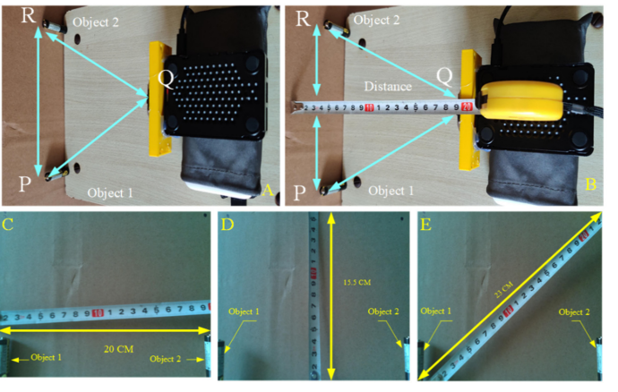
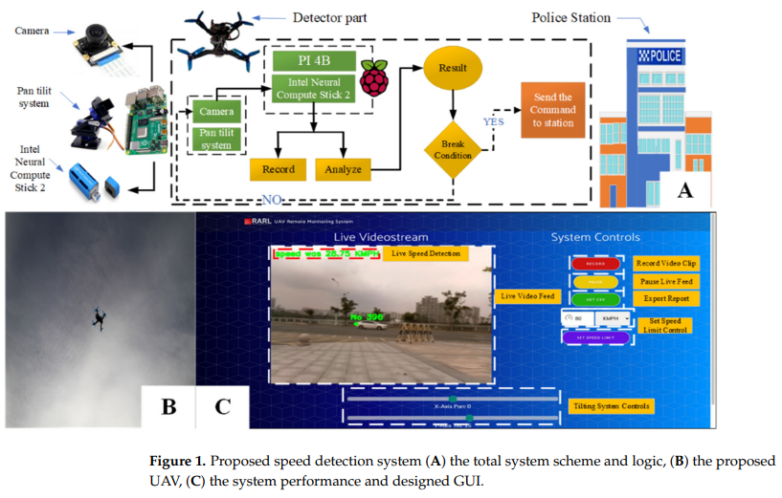
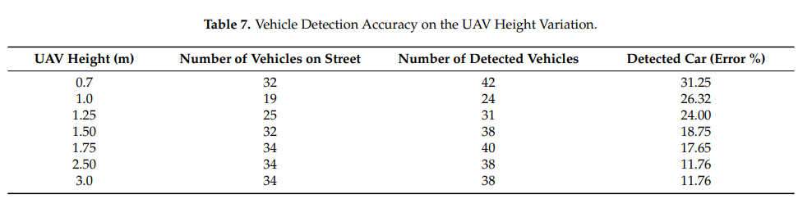
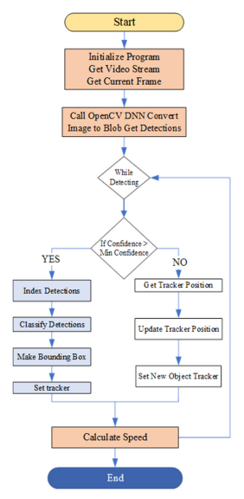
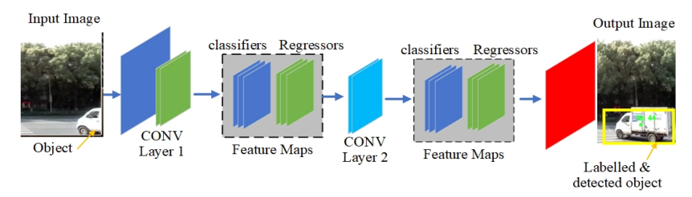
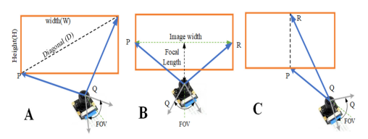
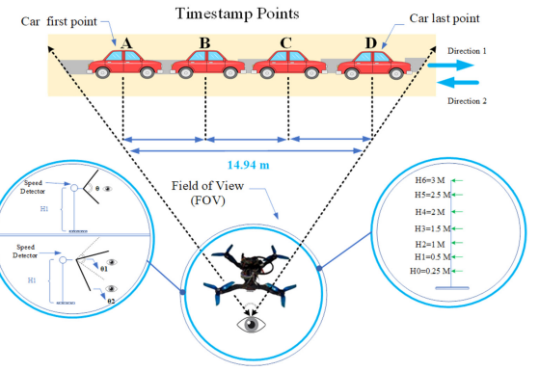
A Secure Traffic Police Remote Sensing Approach via a Deep Learning-Based Low-Altitude Vehicle Speed Detector through UAVs in Smart Cites
Abstract
INTRODUCTION
This paper presents a novel deep learning-based system for real-time vehicle speed detection using low-altitude unmanned aerial vehicles (UAVs) in smart cities. The system employs a MobileNet-SSD deep learning model embedded on a Raspberry Pi 4B processor and Intel Neural Compute Stick 2 for edge-based vehicle detection and speed estimation. The authors evaluated the performance of the proposed system by conducting experiments at different UAV heights (0.7 to 3 meters) and camera angles, demonstrating its effectiveness in accurately detecting and estimating the speeds of vehicles, especially in dynamic and crowded scenarios such as intersections near schools and hospitals. The results show the superiority of the proposed UAV-based system over existing approaches, making it a promising solution for improving traffic safety and security in future smart cities.
Unmanned aerial vehicles (UAVs) have gained significant attention in various remote sensing applications, including transportation management. One such application is the use of UAVs for real-time vehicle speed detection, which can contribute to enhanced traffic safety and security in smart cities. However, most existing vehicle speed estimation methods lack the ability to provide accurate and reliable detection in different situations and scenarios.
To address this gap, this study introduces a novel low-altitude vehicle speed detector system using UAVs for remote sensing applications in smart cities. The proposed system leverages a deep learning-based approach, specifically the MobileNet-SSD model, to detect and estimate the speeds of vehicles. The system is implemented on a Raspberry Pi 4B processor and Intel Neural Compute Stick 2, providing edge-based processing capabilities.
DISCUSSION
RESULTS
The results show the superiority of the UAV-based system over traditional fixed cameras and police officers for real-time vehicle speed monitoring in smart cities. The edge-based processing capabilities and deep learning-powered detection and estimation enable reliable performance even in dynamic traffic conditions. The system's ability to be deployed at low altitudes provides flexibility and reduces privacy concerns compared to higher-altitude UAV solutions. Further research is needed to evaluate the system's performance at larger scales and under varying weather/lighting conditions.
he proposed UAV-based system outperformed existing approaches, demonstrating high effectiveness in accurately detecting and estimating vehicle speeds, especially in crowded areas like intersections near schools and hospitals.
CONCLUSIONS
The proposed UAV-based deep learning system provides a secure and reliable solution for real-time vehicle speed monitoring in smart cities. Key advantages include:
1. Improved accuracy and reliability: The system demonstrated superior performance in detecting and estimating vehicle speeds, especially in crowded, dynamic traffic conditions where traditional methods struggle.
2. Edge-based processing capabilities: Embedding the deep learning model on the Raspberry Pi 4B and Intel Neural Compute Stick 2 enables real-time, on-board processing and inference, avoiding the latency and security issues of cloud-based approaches.
3. Flexible low-altitude deployment: The ability to operate the UAV at low heights (0.7 to 3 meters) provides flexibility in deployment and reduces privacy concerns compared to higher-altitude UAV solutions.
4. Improved traffic safety and security: By accurately monitoring vehicle speeds, the system can help enforce speed limits, identify reckless driving, and enhance overall traffic safety and security in smart cities.
This innovative UAV-based deep learning system overcomes the limitations of existing vehicle speed estimation methods, offering a promising solution to support intelligent transportation management and improve quality of life in smart urban environments.
METHODS AND MATERIALS
The system used a Raspberry Pi 4B processor and Intel Neural Compute Stick 2 as the edge computing hardware, with the MobileNet-SSD deep learning model embedded for real-time vehicle detection and speed estimation.
The researchers optimized the camera's field of view by testing different UAV heights (0.7 to 3 meters) and camera angles in both indoor and outdoor scenarios.
For real-world evaluation, the system was deployed at a university intersection, testing the same range of UAV heights and camera angles. Vehicle speed estimates were compared against ground truth measurements from a laser gun.
Published result
QR
QR

Slide 4
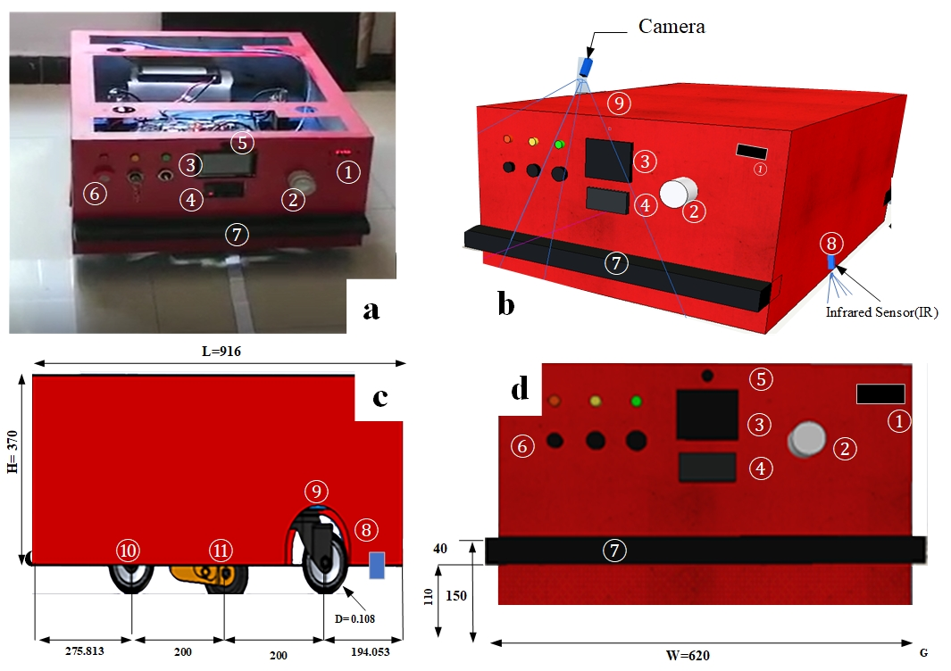
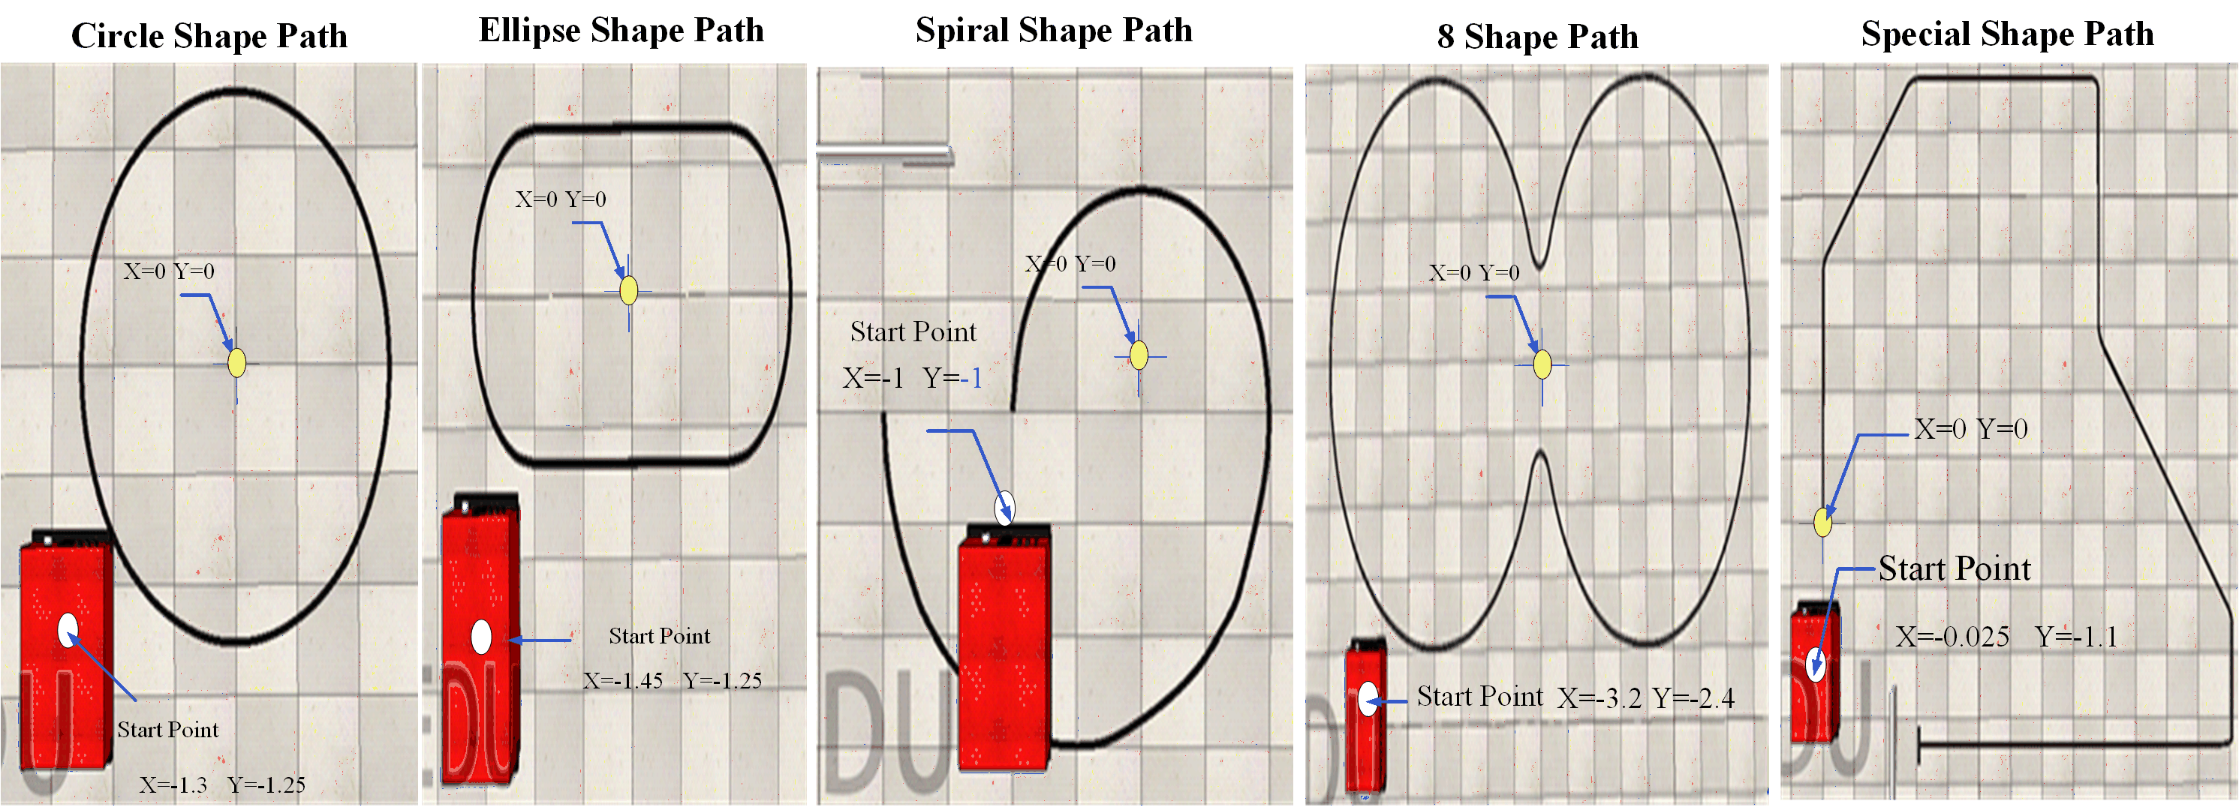

INTRODUCTION
Click here to insert your Introduction text. Type it in or copy and paste from your Word document or other source. Click once on the dashed border to highlight then drag the bottom edge up to fit. Or change the font size to fill the box.
To have the box automatically re-size to your text: Double-click near the edge to open the Format tool, and select ‘Text Box’, then check “Resize AutoShape to Fit Text”.
To change the background color of this text box: Double-click near the edge to open the Format tool, select ‘Colors and Lines’, and change the fill color to whatever you like.
The various elements and text boxes included in this template are examples of what we commonly see on posters of this kind. They are simply placeholders and you should feel free to add, delete, re-arrange, re-name, or re-size as best suits your needs.
ABSTRACT
Click here to insert your Abstract text. Type it in or copy and paste from your Word document or other source.
This text box will automatically re-size to your text.
To change the background color of this text box: Double-click near the edge to open the Format tool, select ‘Colors and Lines’, and change the fill color to whatever you like.
To change the font style of this text box: Click on the border once to highlight the entire text box, then select a different font or font size that suits you. This text is in Arial 22pt and is easily readable up to 3 feet away in a 24x48 poster, and up to 6 feet away in a 48x96 poster (file printed at 200%).
RESULTS
Click here to insert your Introduction text. Type it in or copy and paste from your Word document or other source. Click once on the dashed border to highlight then drag the bottom edge up to fit. Or change the font size to fill the box.
To have the box automatically re-size to your text: Double-click near the edge to open the Format tool, and select ‘Text Box’, then check “Resize AutoShape to Fit Text”.
To change the background color of this text box: Double-click near the edge to open the Format tool, select ‘Colors and Lines’, and change the fill color to whatever you like.
The various elements and text boxes included in this template are examples of what we commonly see on posters of this kind. They are simply placeholders and you should feel free to add, delete, re-arrange, re-name, or re-size as best suits your needs.
DISCUSSION
Click here to insert your Introduction text. Type it in or copy and paste from your Word document or other source. Click once on the dashed border to highlight then drag the bottom edge up to fit. Or change the font size to fill the box.
To have the box automatically re-size to your text: Double-click near the edge to open the Format tool, and select ‘Text Box’, then check “Resize AutoShape to Fit Text”.
To change the background color of this text box: Double-click near the edge to open the Format tool, select ‘Colors and Lines’, and change the fill color to whatever you like.
The various elements and text boxes included in this template are examples of what we commonly see on posters of this kind. They are simply placeholders and you should feel free to add, delete, re-arrange, re-name, or re-size as best suits your needs.
Published result
Video
Ferrández-Pastor, Francisco, et al. "Developing ubiquitous sensor network platform using internet of things: Application in precision agriculture." Sensors 16.7 (2016): 1141
Gondchawar, Nikesh, and R. S. Kawitkar. "IoT based smart agriculture." International Journal of advanced research in Computer and Communication Engineering 5.6 (2016): 838-842
Krishna, K. L., Silver, O., Malende, W. F., & Anuradha, K. (2017). Internet of Things application for implementation of smart agriculture system. 2017 International Conference on I-SMAC (IoT in Social, Mobile, Analytics and Cloud) (I-SMAC). doi:10.1109/i-smac.2017.8058236
P. J. Sarkar and S. Chanagala, “IoT based Digital Agriculture Monitoring System & Their Impact on Optimal Utilization of Resources,” J. Res. Vol., vol. 4, no. 01, pp. 1–4, 2018
QR
QR

Slide 5

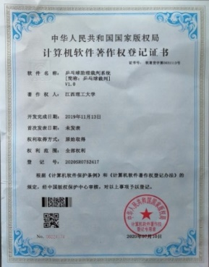

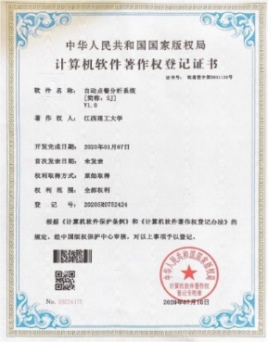
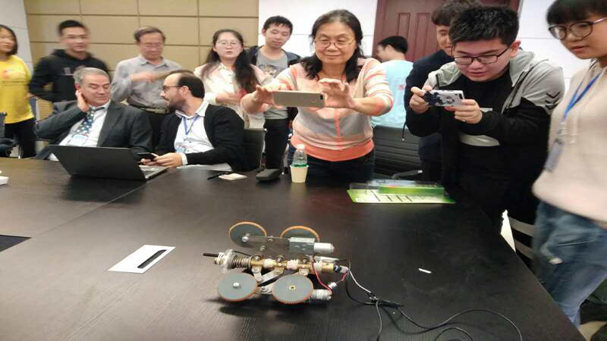
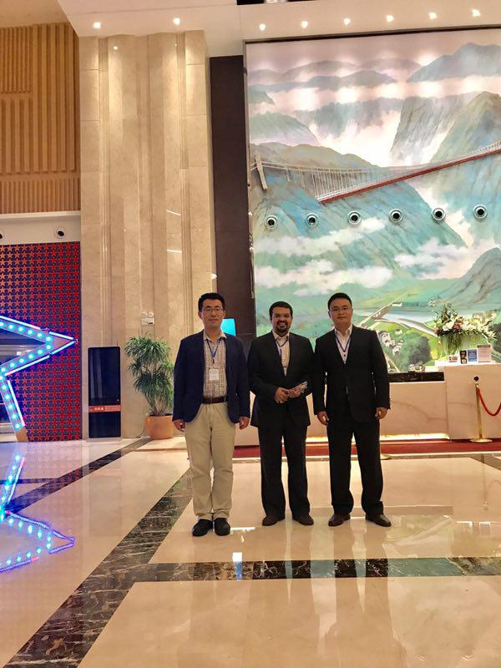
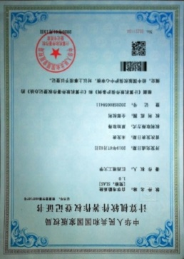
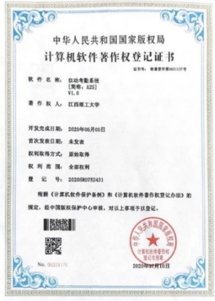
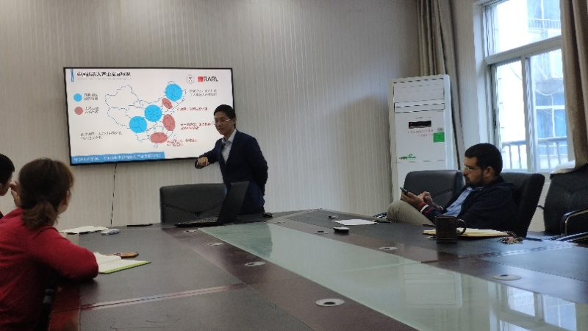
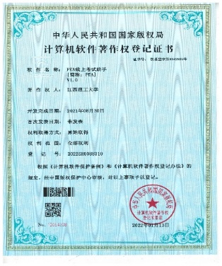
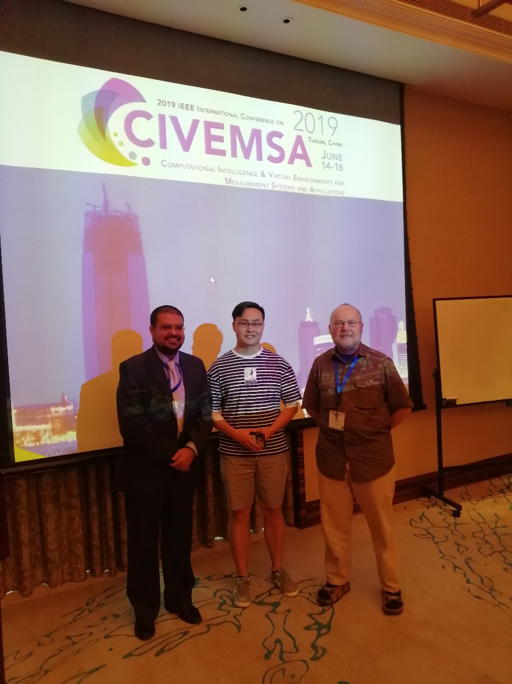
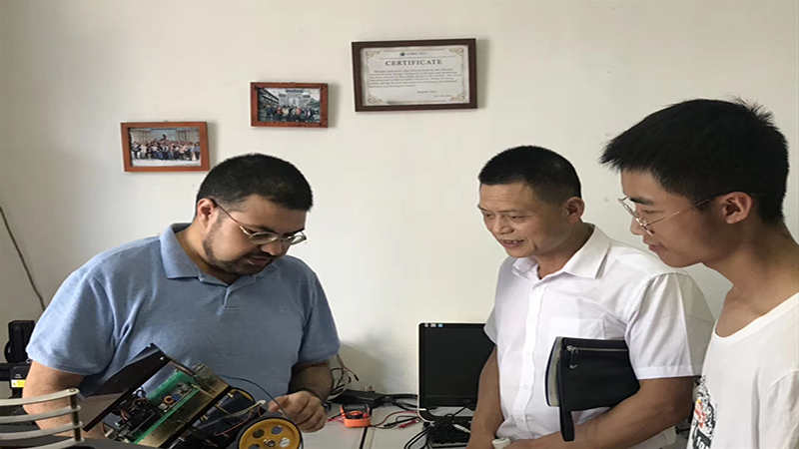

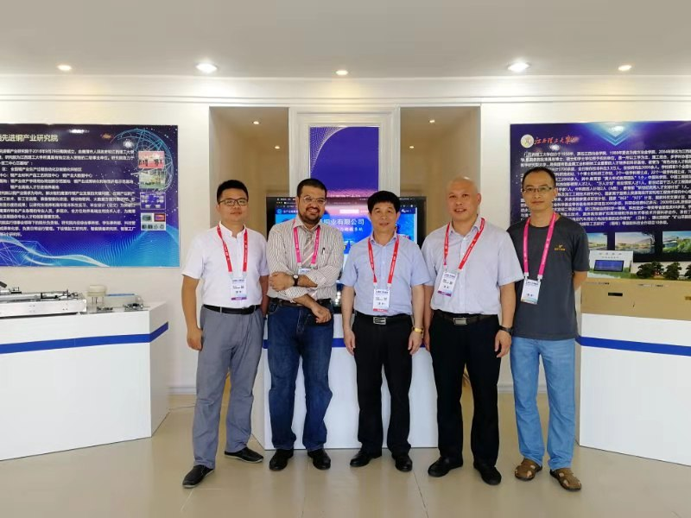
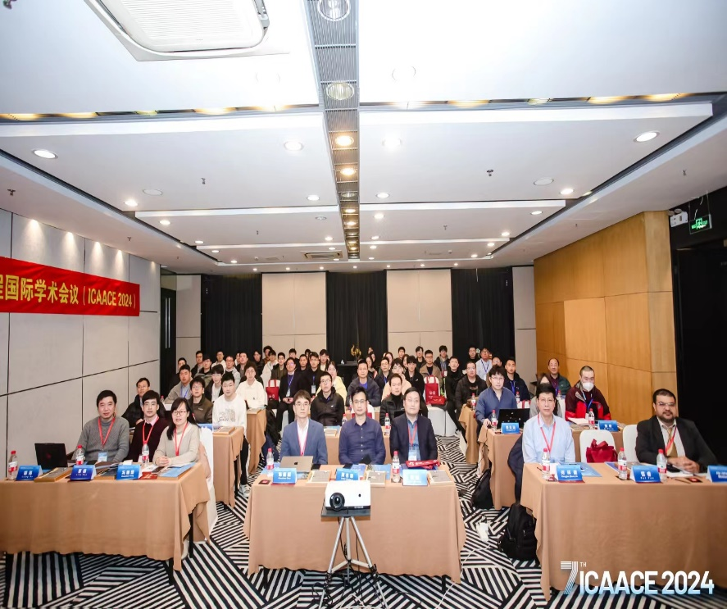
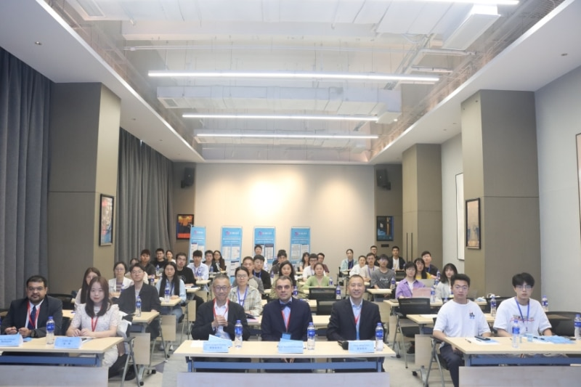
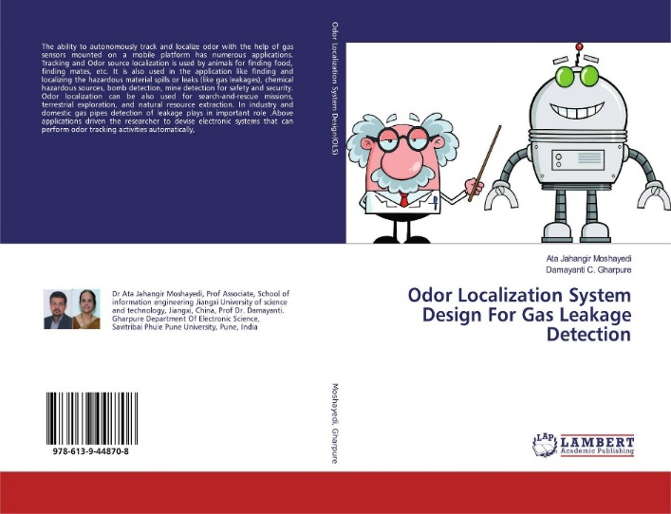
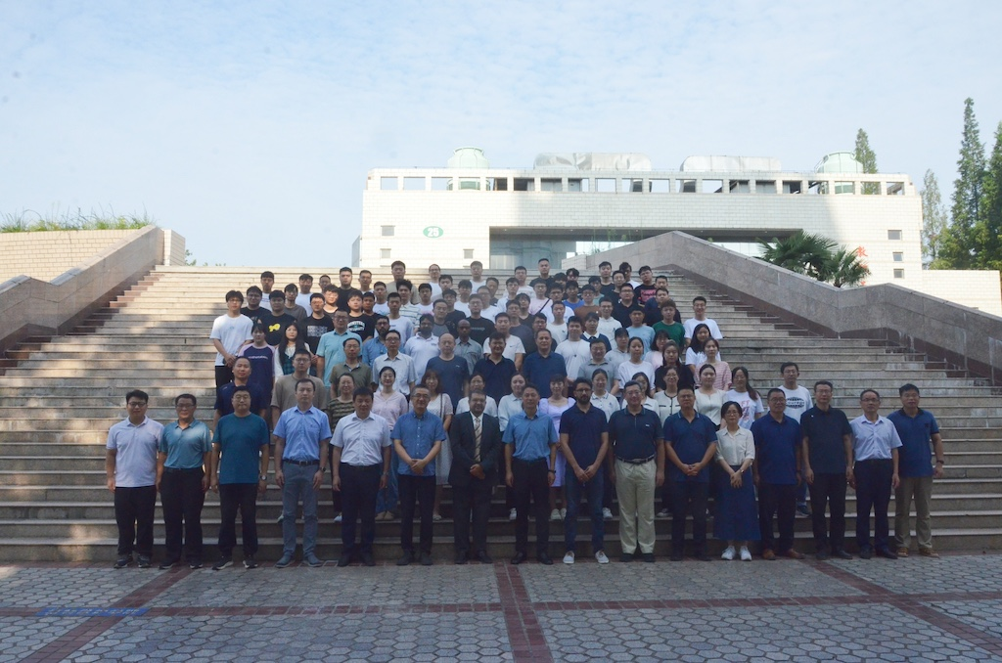
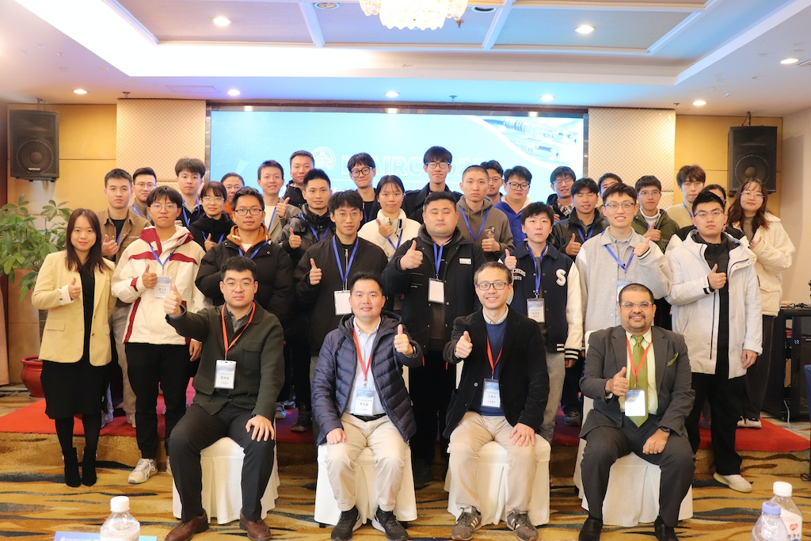
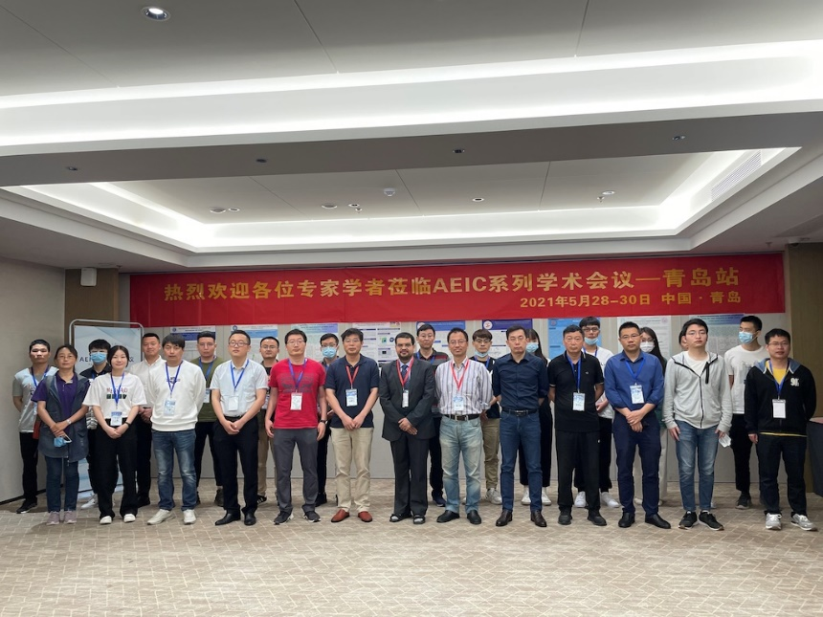
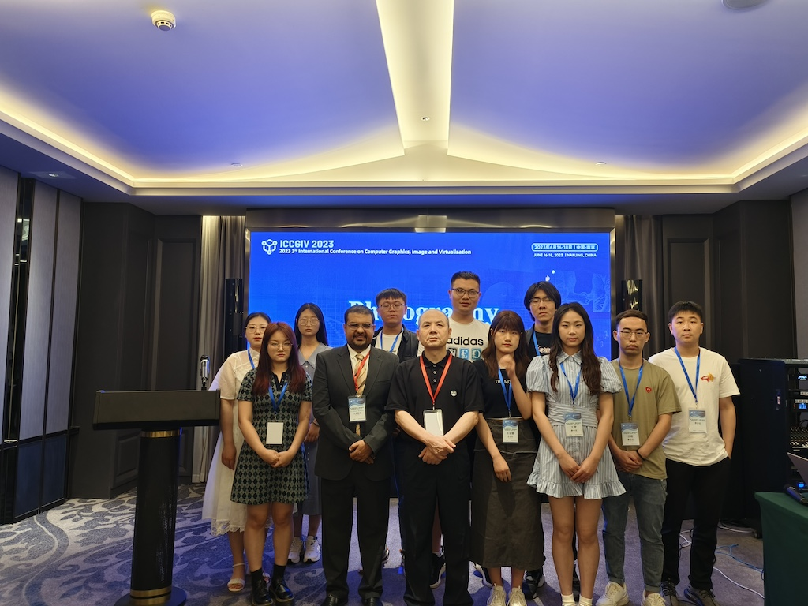

Robotics And Research Automaton Lab (RARL]
RESULTS
Welcome To RARL
This centre is started to develop design and various robot specially in the filed of service robot and active in automation project. The main target over than research in this filed is consulting and help industry for automation solution.
5
2019
DISCUSSION
Click here to insert your Introduction text. Type it in or copy and paste from your Word document or other source. Click once on the dashed border to highlight then drag the bottom edge up to fit. Or change the font size to fill the box.
To have the box automatically re-size to your text: Double-click near the edge to open the Format tool, and select ‘Text Box’, then check “Resize AutoShape to Fit Text”.
To change the background color of this text box: Double-click near the edge to open the Format tool, select ‘Colors and Lines’, and change the fill color to whatever you like.
The various elements and text boxes included in this template are examples of what we commonly see on posters of this kind. They are simply placeholders and you should feel free to add, delete, re-arrange, re-name, or re-size as best suits your needs.
2022

